Slide 1



Movies Report
View in Power BI
Last data refresh:
1/27/2025 12:57:24 PM UTC
Downloaded at:
2/6/2025 8:16:18 AM UTC

Slide 2
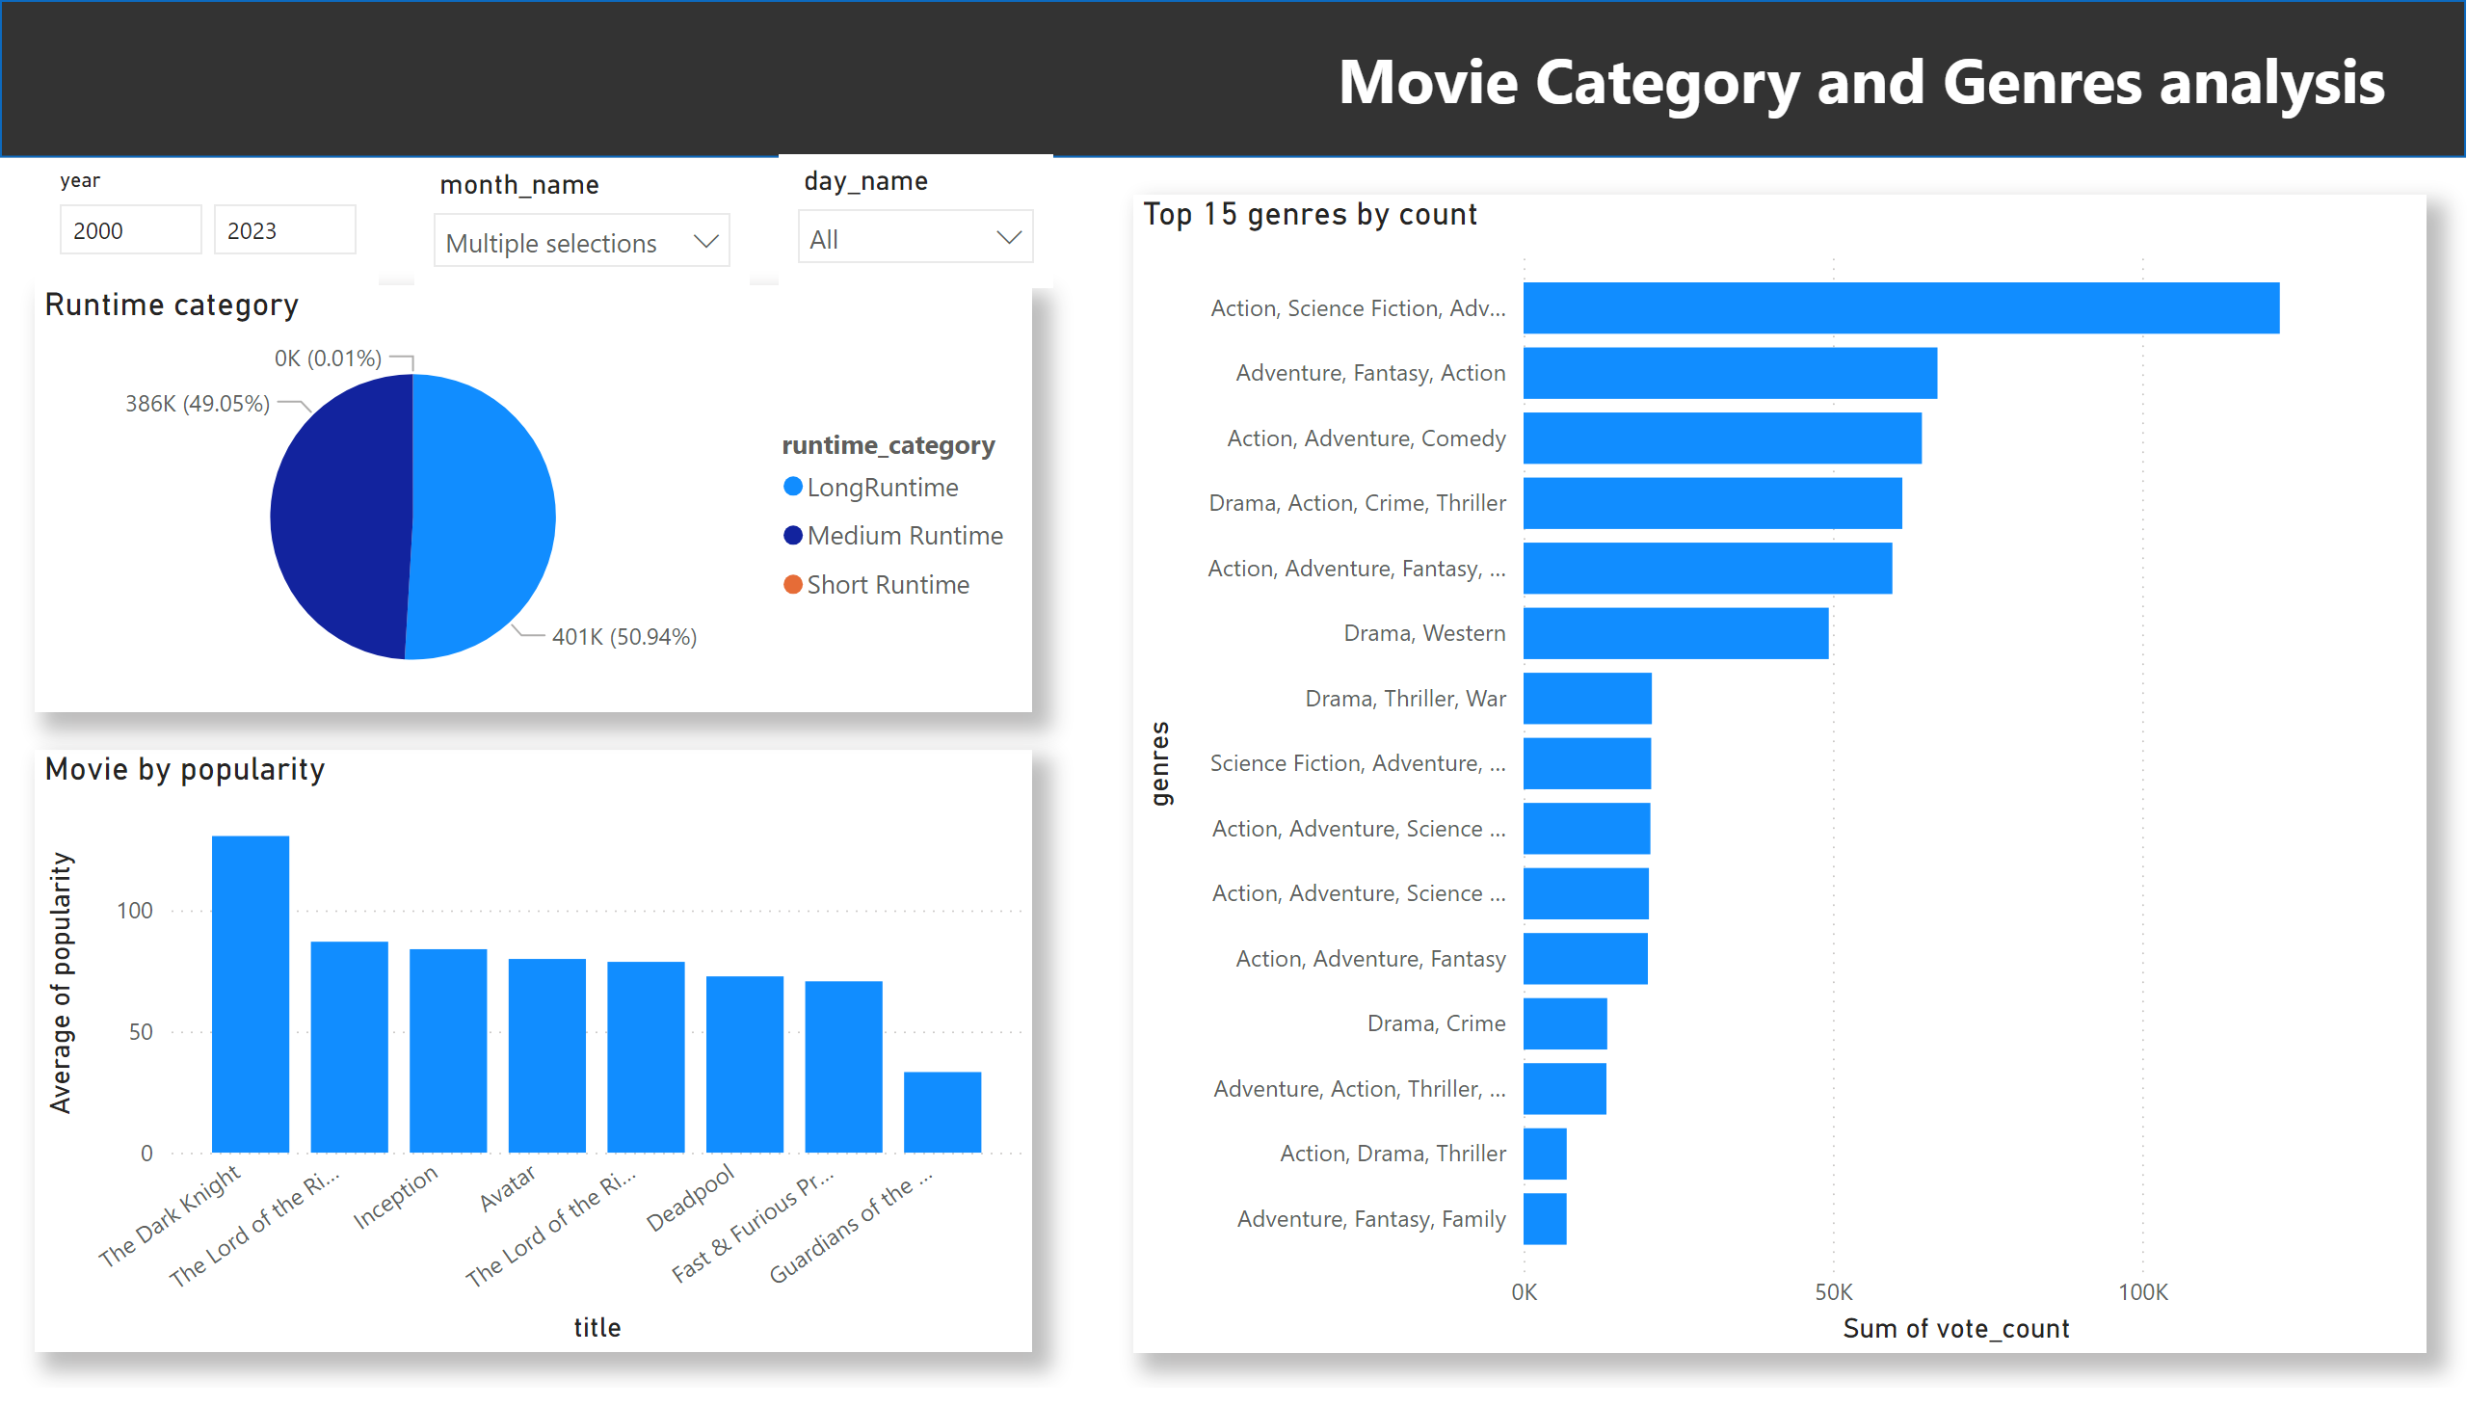
Genre and Category
Notes:
shape
No alt text provided
Movie by popularity
No alt text provided
Top 15 genres by count
No alt text provided
Runtime category
No alt text provided
slicer
No alt text provided
slicer
No alt text provided
slicer
No alt text provided
textbox
No alt text provided

Slide 3
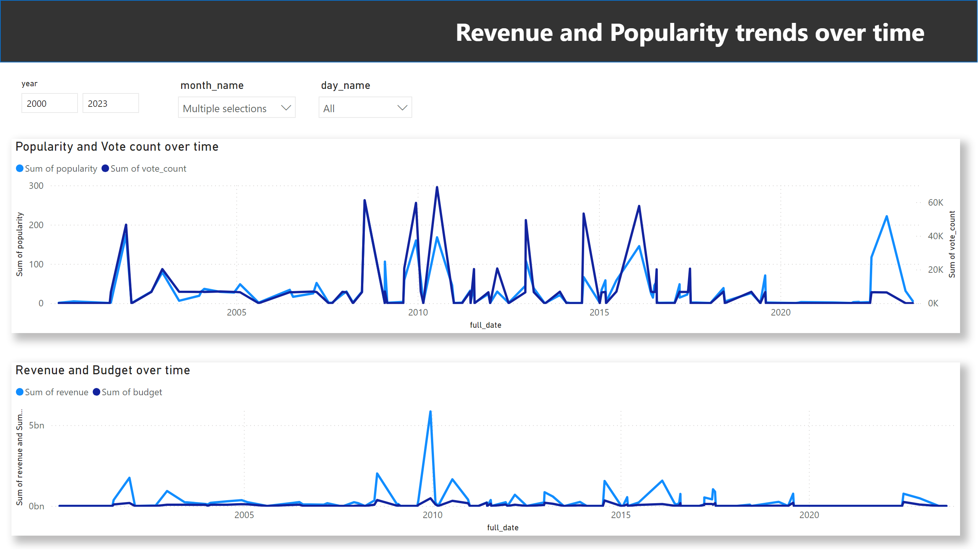
Time Series
Notes:
shape
No alt text provided
Popularity and Vote count over time
No alt text provided
slicer
No alt text provided
slicer
No alt text provided
slicer
No alt text provided
Revenue and Budget over time
No alt text provided
textbox
No alt text provided

